Slide 1
Microbial Pathogenesis & mechanisms
prof.dr.ihsan edan alsaimary department of microbiology – college of medicine – university of basrah

Slide 2
Basic terms frequently used in describing aspects of pathogenesis:
Pathogenicity:
The ability of an infectious agent to cause disease.
Virulence:
The quantitative ability of an agent to cause disease.
Virulent agents cause disease when introduced into the host in small numbers.
Virulence involves invasiveness and toxigenicity.

Slide 3
Basic terms frequently used in describing aspects of pathogenesis:
Toxigenicity:
The ability of a microorganism to produce a toxin that contributes to the development of disease.
Invasion:
The process whereby bacteria, parasites, fungi and viruses enter the host cells or tissues and spread in the body.

Slide 4
Basic terms frequently used in describing aspects of pathogenesis:
Pathogen:
A microorganism capable of causing disease.
Non-pathogen:
A microorganism that does not cause disease. It may be part of the normal flora.
Opportunistic pathogen:
An agent capable of causing disease only when the host´s resistance is impaired (e.g. the patient is immunocompromised).
An agent capable of causing disease only when spread from the site with normal bacterial microflora to the sterile tissue or organ.

Slide 5
The microbial flora is determined by a variety of factors:
age
diet
hormonal state
health
personal hygiene
The human fetus lives in a protected, sterile environment, the newborn is exposed to microbes from the mother and environment.
The infant´s skin is colonized first, followed by the oropharynx, gastrointestinal tract, and other mucosal surfaces.

Slide 6
Exposure of an individual to bacteria can lead to one of three outcomes:
The bacteria can transiently colonize the person.
The bacteria can permanently colonize the person.
The bacteria can produce disease.

Slide 7
An understanding of medical microbiology requires knowledge not only of the different classes of bacteria but also of their propensity for causing disease.
Strict pathogens:
Mycobacterium tuberculosis,
Neisseria gonorrhoeae, Francisella tularensis, Plasmodium spp., rabies virus
Opportunistic pathogens:
e.g. bacteria that are typically members of the human ´s normal microflora (Staphylococcus epidermidis , Escherichia coli and other)

Slide 8
In 1884, Robert Koch proposed a series of postulates in his treatise on Mycobacterium tuberculosis and tuberculosis. These postulates have been applied more broadly to link many specific bacterial species with particular diseases.

Slide 9
Koch´s postulates (GERM THEORY) are summarized as follows:
The microorganism should be found in all cases of the disease in question, and its distribution in the body should be in accordancce with the lesions observed.
The microorganism should be grown in pure culture in vitro (or outsite the body of the host) for several generations.
When such a pure culture is inoculated into susceptible animal species, the typical disease must result.
The microorganism must again be isolated from the lesions of such experimentally produced disease.

Slide 10
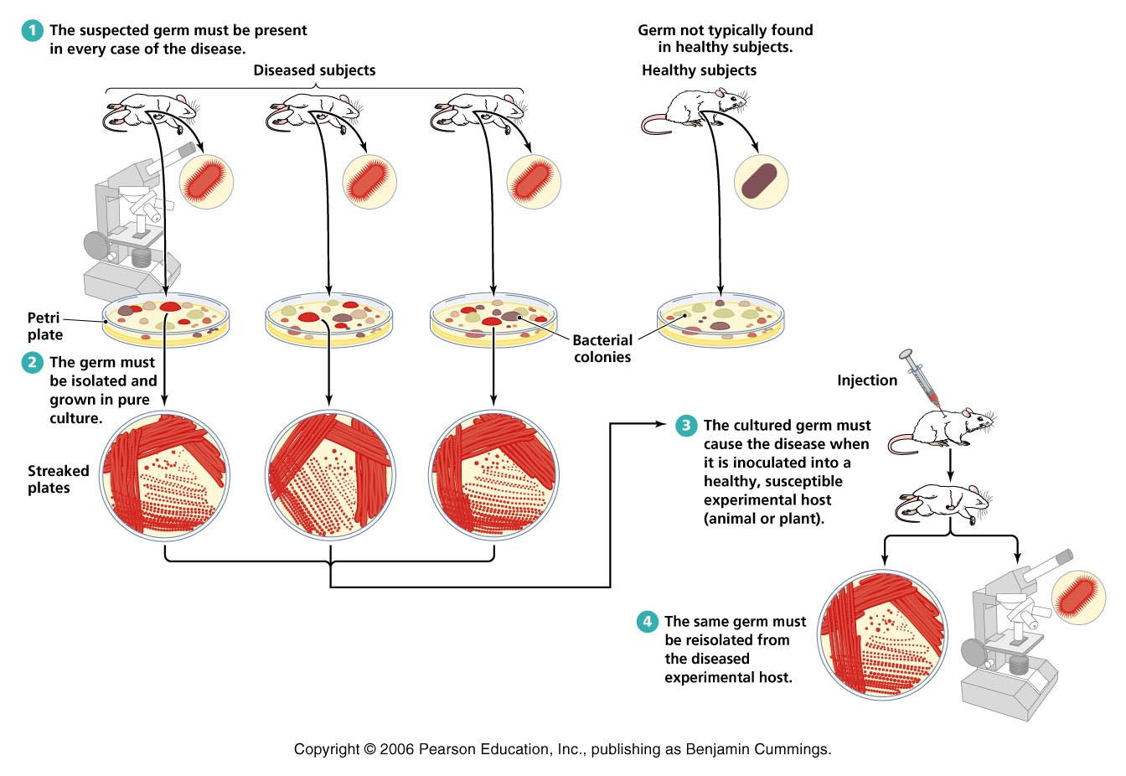
Koch’s Postulates
Figure 14.7

Slide 11
Exceptions to Koch’s Postulates
Using Koch’s postulates is not feasible in all cases
Some pathogens can’t be cultured in the laboratory
Some diseases are caused by a combination of pathogens and other cofactors
Ethical considerations prevent applying Koch’s postulates to pathogens that require a human host

Slide 12
Virulence Factors of Infectious Disease
Pathogenicity – ability of a microorganism to cause disease
Virulence – degree of pathogenicity
Virulence factors contribute to an organisms virulence
Adhesion factors
Biofilms
Extracellular enzymes
Toxins
Antiphagocytic factors

Slide 13
Extracellular Enzymes
Enzymes secreted by the pathogen
Dissolve structural chemicals in the body
Help pathogen maintain infection, invade further, and avoid body defenses

Slide 14
Toxins
Chemicals that harm tissues or trigger host immune responses that cause damage
Toxemia refers to toxins in the bloodstream that are carried beyond the site of infection
Two types
Exotoxins
Endotoxins

Slide 15
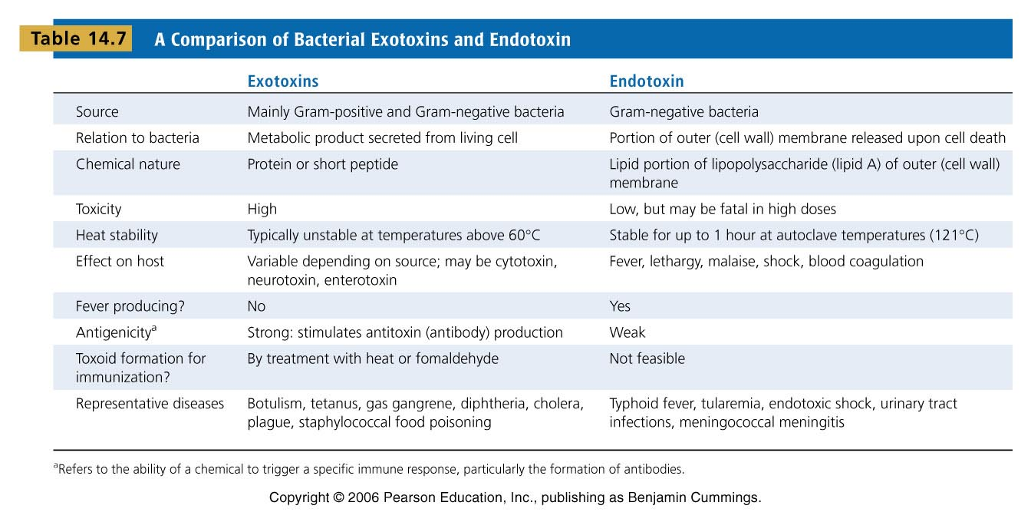
A Comparison of Bacterial Exotoxins and Endotoxins
Table 14.7

Slide 16
Exotoxins associated with diarrheal diseases
Vibrio cholerae toxin
Staphylococcus aureus enterotoxin
Other enterotoxins - enterotoxins are also produced by some strains of:
Yersinia enterocolitica
Vibrio parahaemolyticus
Aeromonas species

Slide 17
Antiphagocytic Factors
Certain factors prevent phagocytosis by the host’s phagocytic cells
Bacterial capsule
Often composed of chemicals found in the body and not recognized as foreign
Can be slippery making it difficult for phagocytes to engulf the bacteria
Antiphagocytic chemicals
Some prevent fusion of lysosome and phagocytic vesicles
Leukocidins directly destroy phagocytic white blood cells

